Slide 1
The Transmission of Monetary Policy to Household Wealth Channels
Method: Deep Reinforcement Learning

Slide 2
The Transmission of Monetary Policy to Household Wealth Channels
Research Question (temporarily)
How does the transmission of monetary policy impact household wealth channels?
Method
I propose using deep reinforcement learning (DRL) to analyze the dynamics of household wealth channels in response to changes in monetary policy. DRL is well-suited for solving problems with high dimensionality and complexity. It also allows for heterogenous actions within a simulated environment, reflecting real choices of a household.

Slide 3
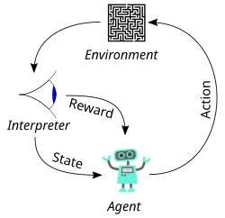
Deep Reinforcement Learning (DRL): A simple case

Slide 4
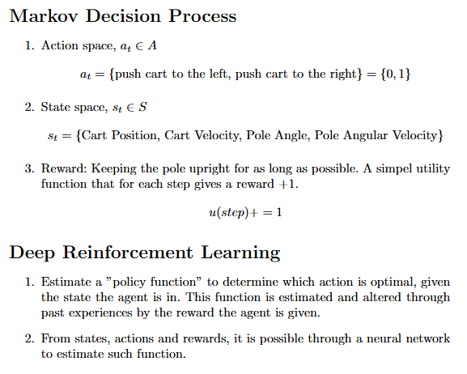
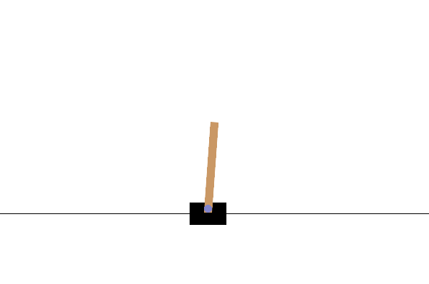
Deep Reinforcement Learning (DRL): A simple case

Slide 5
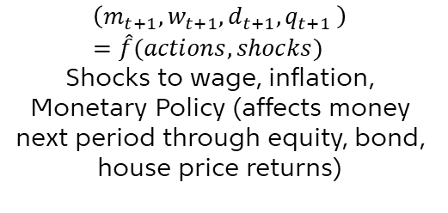

Connecting DRL to Economics (and the RQ)
Agent = Household
Policy by Neural Network: Consume, labour hours, debt, investments Estimated by ANN
Agent decide actions
Agent Observes state
Policy update
Reinforcement Learning
Action:
Consumption
Labour hours
Obtain debt
Allocate resources to investments (bonds, equities and housing)
States:
$$(m_{t}, w_{t},d_{t}, q_{t})$$
Reward: Based on consumption, house holdings and disutility from labour hours
Environment Actions and Shocks
$$\left(m_{t+1},w_{t+1},d_{t+1},q_{t+1} \right)=\hat{f}(actions, shocks)$$
Shocks to wage, inflation, Monetary Policy (affects money next period through equity, bond, house price returns)
Agent recieves reward from actions

Slide 6
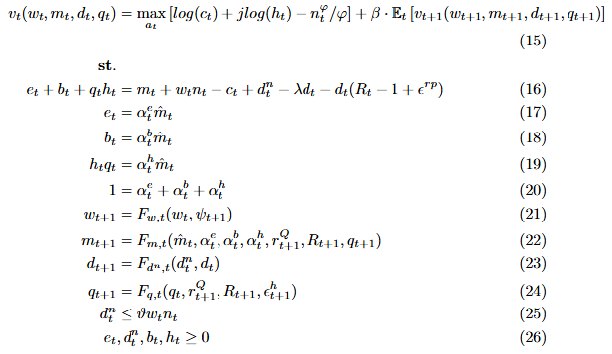
Bellman Equation (The household optimization problem)
Your take on the current Bellman Equation
Improvements to the current problem
Economic sense
Reflecting a semi-real-world scenario

Slide 7
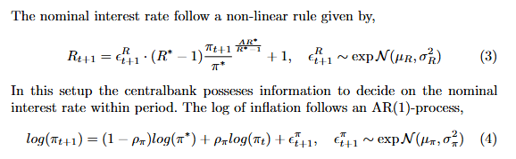


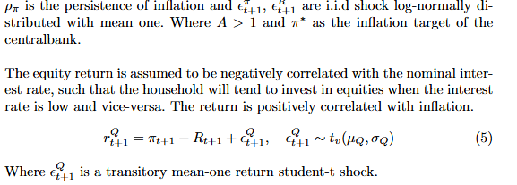


Bellman Equation (The household optimization problem)

